Slide 1


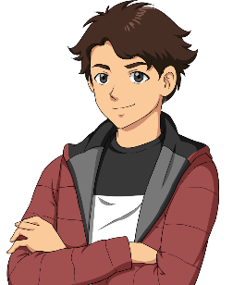

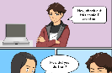


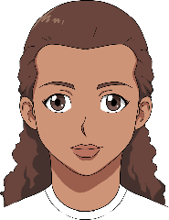


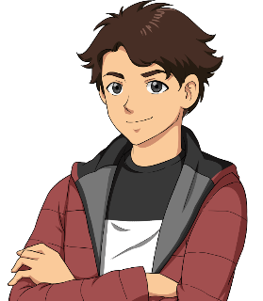
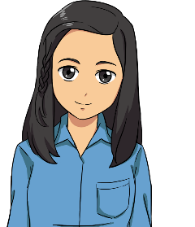

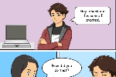
Intro slide 1
Hey!
Welcome to Voices on Paper.
What is that?
It’s a Table Read group.
We help writers polish their dialogue and stories with actionable feedback from script doctors.

Slide 2
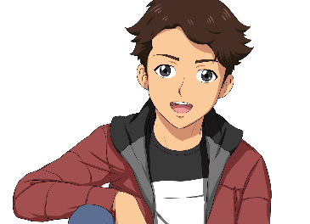
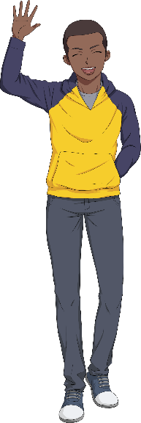
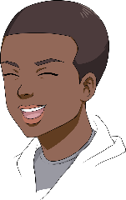
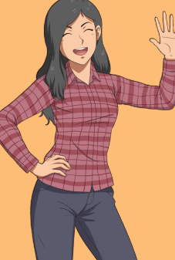
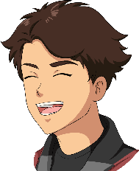
Intro slide 2
visit
www.yourvoicesonpaper.com
Here’s the process.
What do we do?
We cast, read, offer feedback, and answer any questions on any genre, format, and length of TV or Film script.
We need a list of all speaking characters with descriptions, a copy of the script, and any notes you’d like us to take into account.
You can record the read and reasonable requests may be accommodated.
Requirements?
All scripts must be registered or have a copyright.

Slide 3


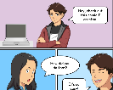
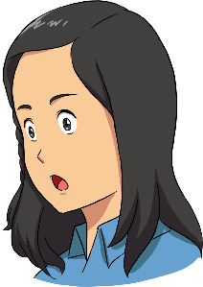
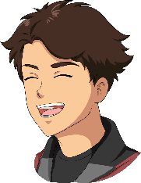
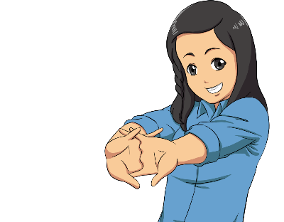
Intro slide 3
That's so cool! When and where are the meetings?
123690
Mondays/Tuesdays via Zoom
7pm PDT for scripts up to
99 pages
6:30pm for 100+ pages
*dates/times flexible

Slide 4

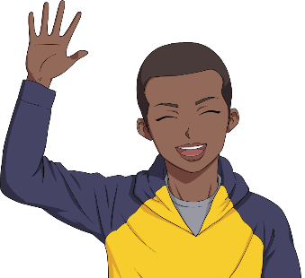
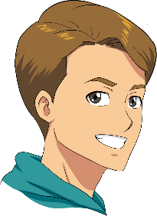

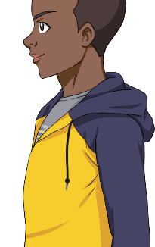
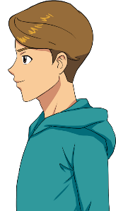
Example slide 2
How do I submit my script?
Contact us via email:
voicesonpaper@yourvoicesonpaper.com
Awesome!
They’ll set up a date for the read et voilà!

Slide 5
The Lab
Submission
Requirements
ALL SCRIPT MUST BE REGISTERED OR HAVE A COPYRIGHT
Pilots, episodic scripts, features, and short films.
Any genre.
SUBMIT TO voicesonpaper@yourvoicesonpaper.com
Title
Genre
Number of pages
Synopsis (short)
Logline
Tagline (optional)
List of speaking roles with character descriptions
Copy of the script
Writer’s notes
Who referred you
to VOP?
PROCESS:
We start the meeting with introductions, read your script, and give feedback on story and format. Then the floor is yours to ask additional questions about your work.
All done over Zoom.

Slide 6

ABOUT US
WHAT IS VOICES ON PAPER?
Voices On Paper is a group of passionate actors, writers, and script doctors who came together to help each other improve their scripts, which went on to place within the 10% of various screenwriting competitions. The chemistry between the members sparked so organically that VOP expanded into a weekly table read workshop group to help other writers. Forming a team with a progressive mindset, VOP aims to provide a safe space for storytellers and deliver quality performances with actionable feedback.
Our mission is to foster collaborative minds and talents together to revise good scripts into great scripts, and great scripts into exceptional ones.
IS VOICES ON PAPER RIGHT FOR ME?
VOP is prepared to help writers from first-timers to veterans.
Hearing your script out loud helps immensely with dialogue, flow, and pacing, plus you get feedback on the spot from writers and script doctors, on characters, plot, structure, concept, theme, and more.
Do you have a script you want to enter into competitions? Have you entered a script but didn’t break into the finalist spots? Do you have a strong script and want peers to give you honest professional critiques to take it to the next level?
We will help develop, revamp, and/or tighten it up, with proper suggestions for dramatic and humorous moments.

Slide 7
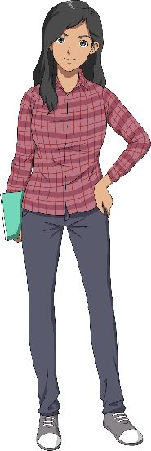
Example slide 1
Voices on Paper provides a safe space for creatives to share their work,
hear their concepts and dialogue
out loud, and receive
constructive criticism
through the lenses
of individuals who
have had entirely
different life
experiences
and points of view.
VOP has been working together on a weekly basis since August 2020. Our members have studied various acting methods and won numerous awards for performing, writing, directing, producing, and more.
V
o
P
The VOP team ranges wide in ethnic diversity, ages, LGBTQAI+ and allies, gender bending, foreign languages, and talents for accents, dialects, and voices.

Slide 8
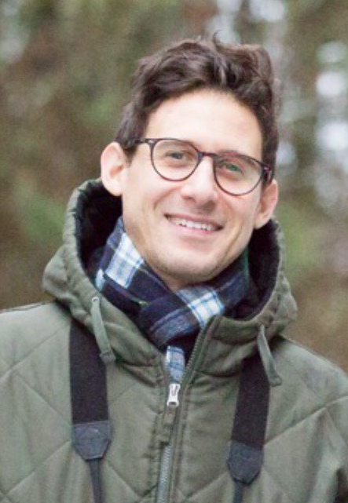
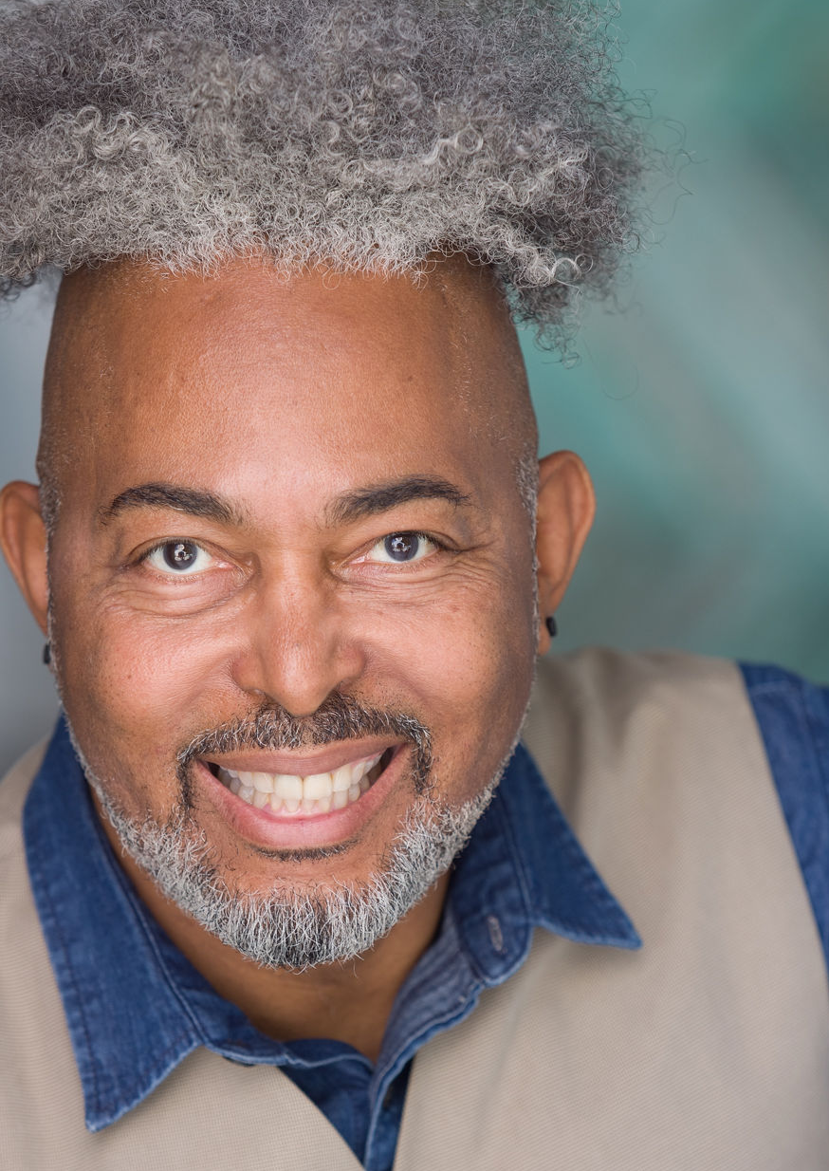
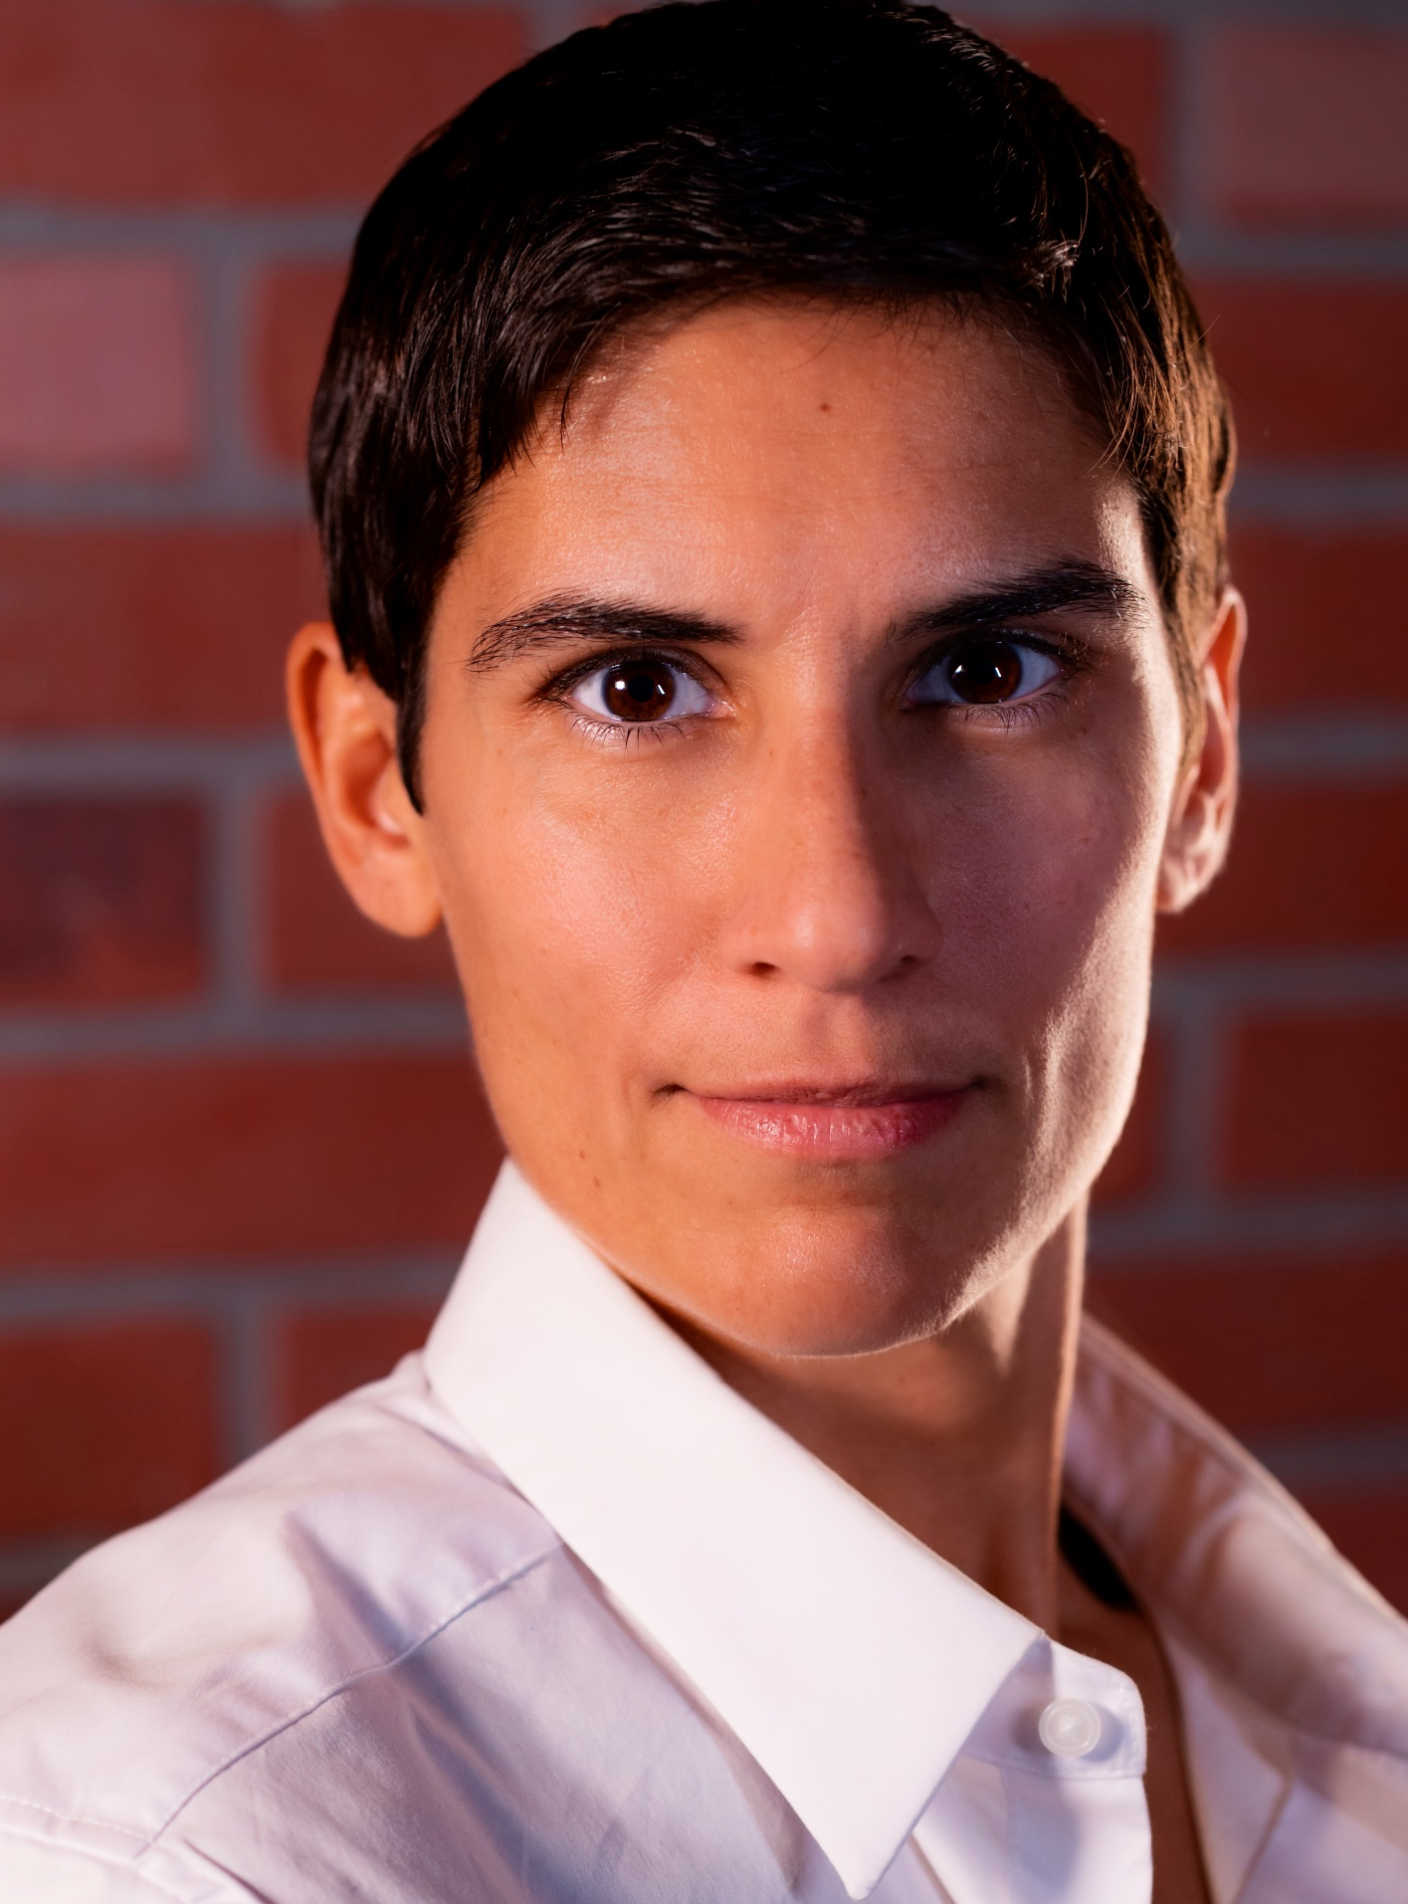
People slide 3
JOEL
Narrator
DALE
Actor/Writer
CRIS
Actor/Writer
Joel Handler is a Los Angeles-based screenwriter, script consultant, film scout for Porter Pictures, and reader for The Black List. His politely-smack-you-right-in-the-face comedy style earned him a spot in Cinequest 2021's Top Ten Finals. His goal is to write standout, inclusive comedy for a major network or streaming service.
Dale Madison originally from Baltimore, Maryland, is an award-winning educator, LGBTQ activist, playwright, author, performance artist, doll collector & designer, and
artist-in-residence.
He moved to Los Angeles in 2000 with his one-man show FREEda slave: Mask of A Diva.
CristiAna “Cris” Felipe
European-American, nonbinary athlete, living in Los Angeles, super passionate about writing and performing for films, TV, + music.
Fluent in French
and Portuguese,
Cris has a BA in Film Studies and Production from Hofstra University, and 8+ years experience in stand-up comedy.
Voices On Paper

Slide 9
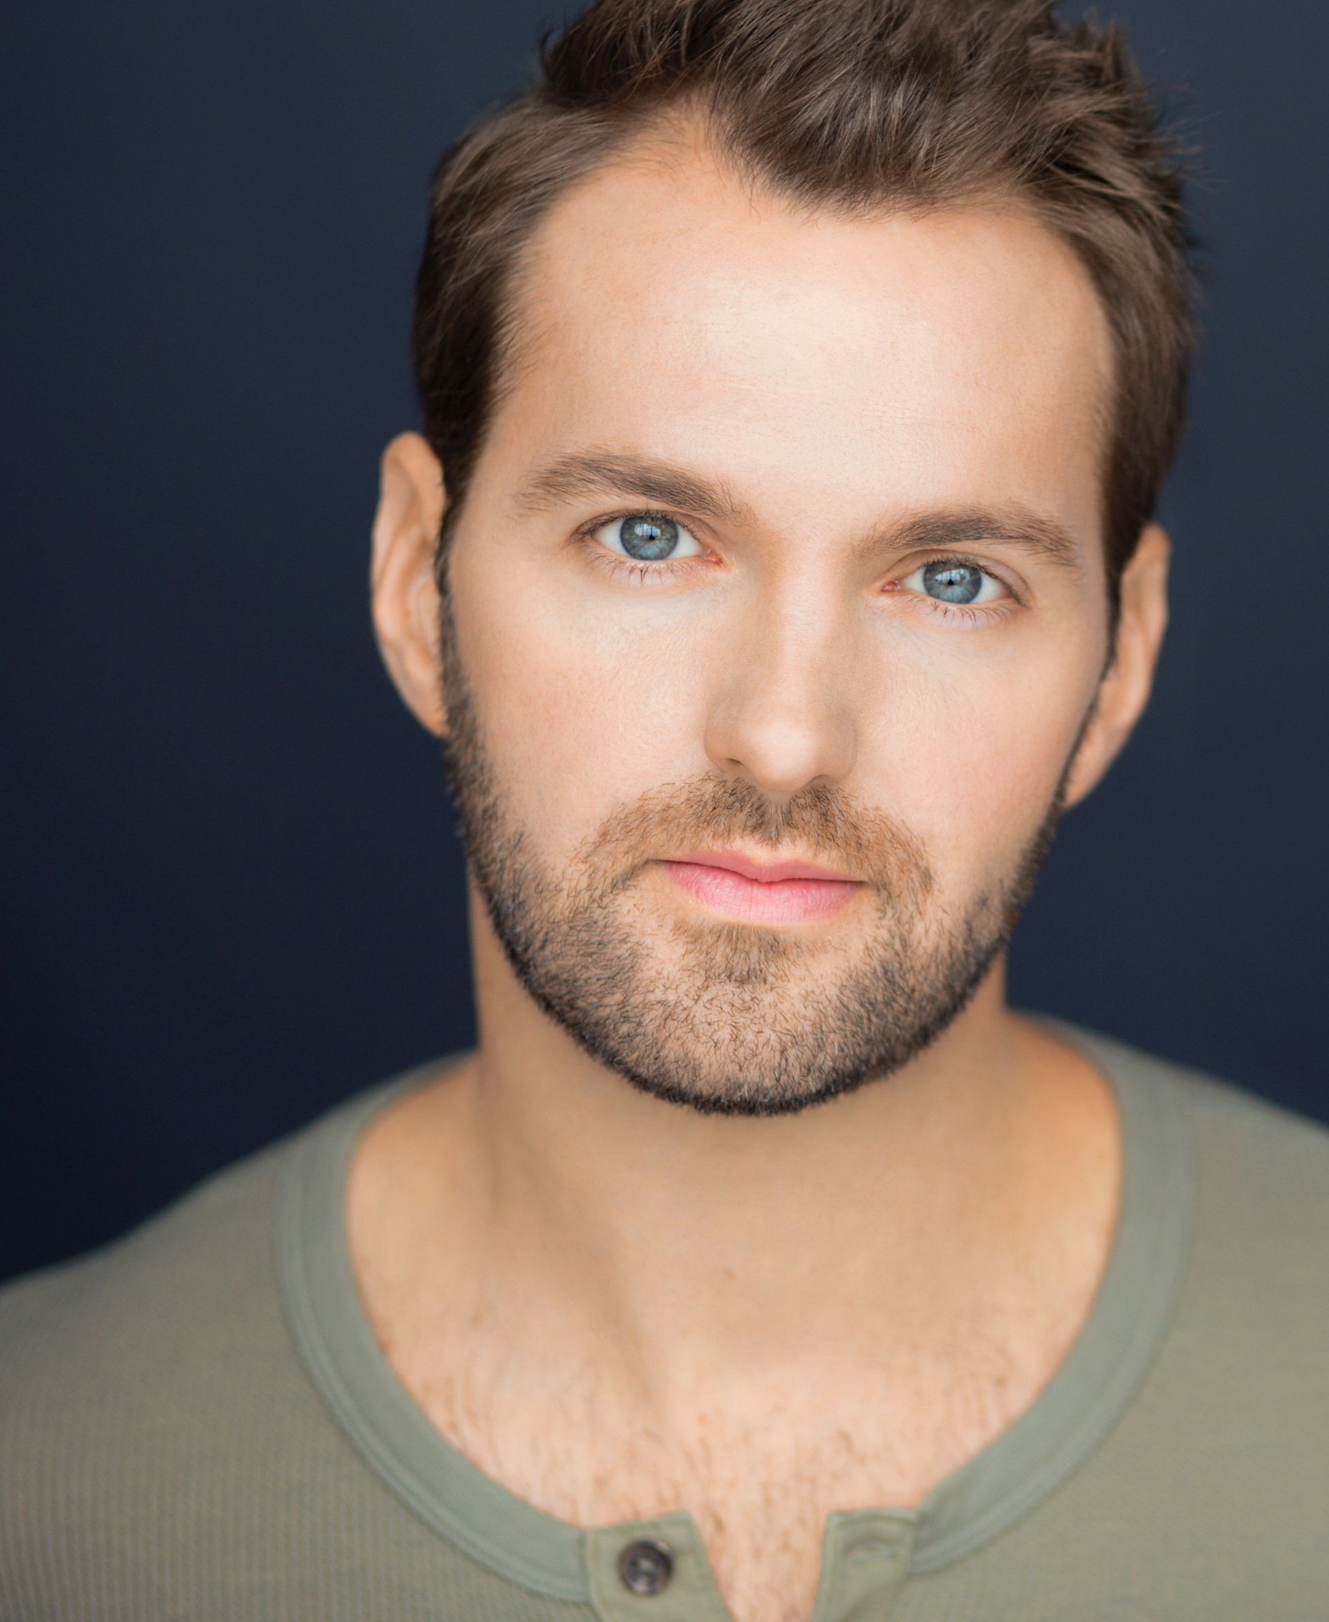
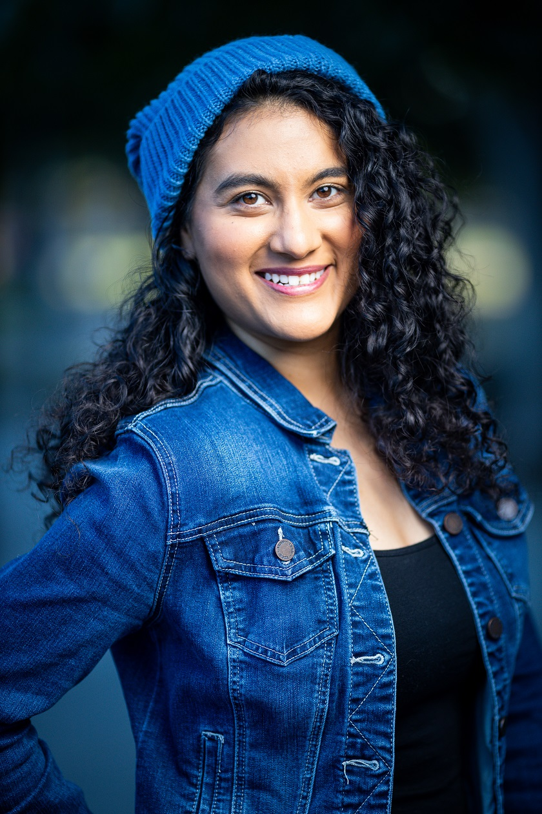
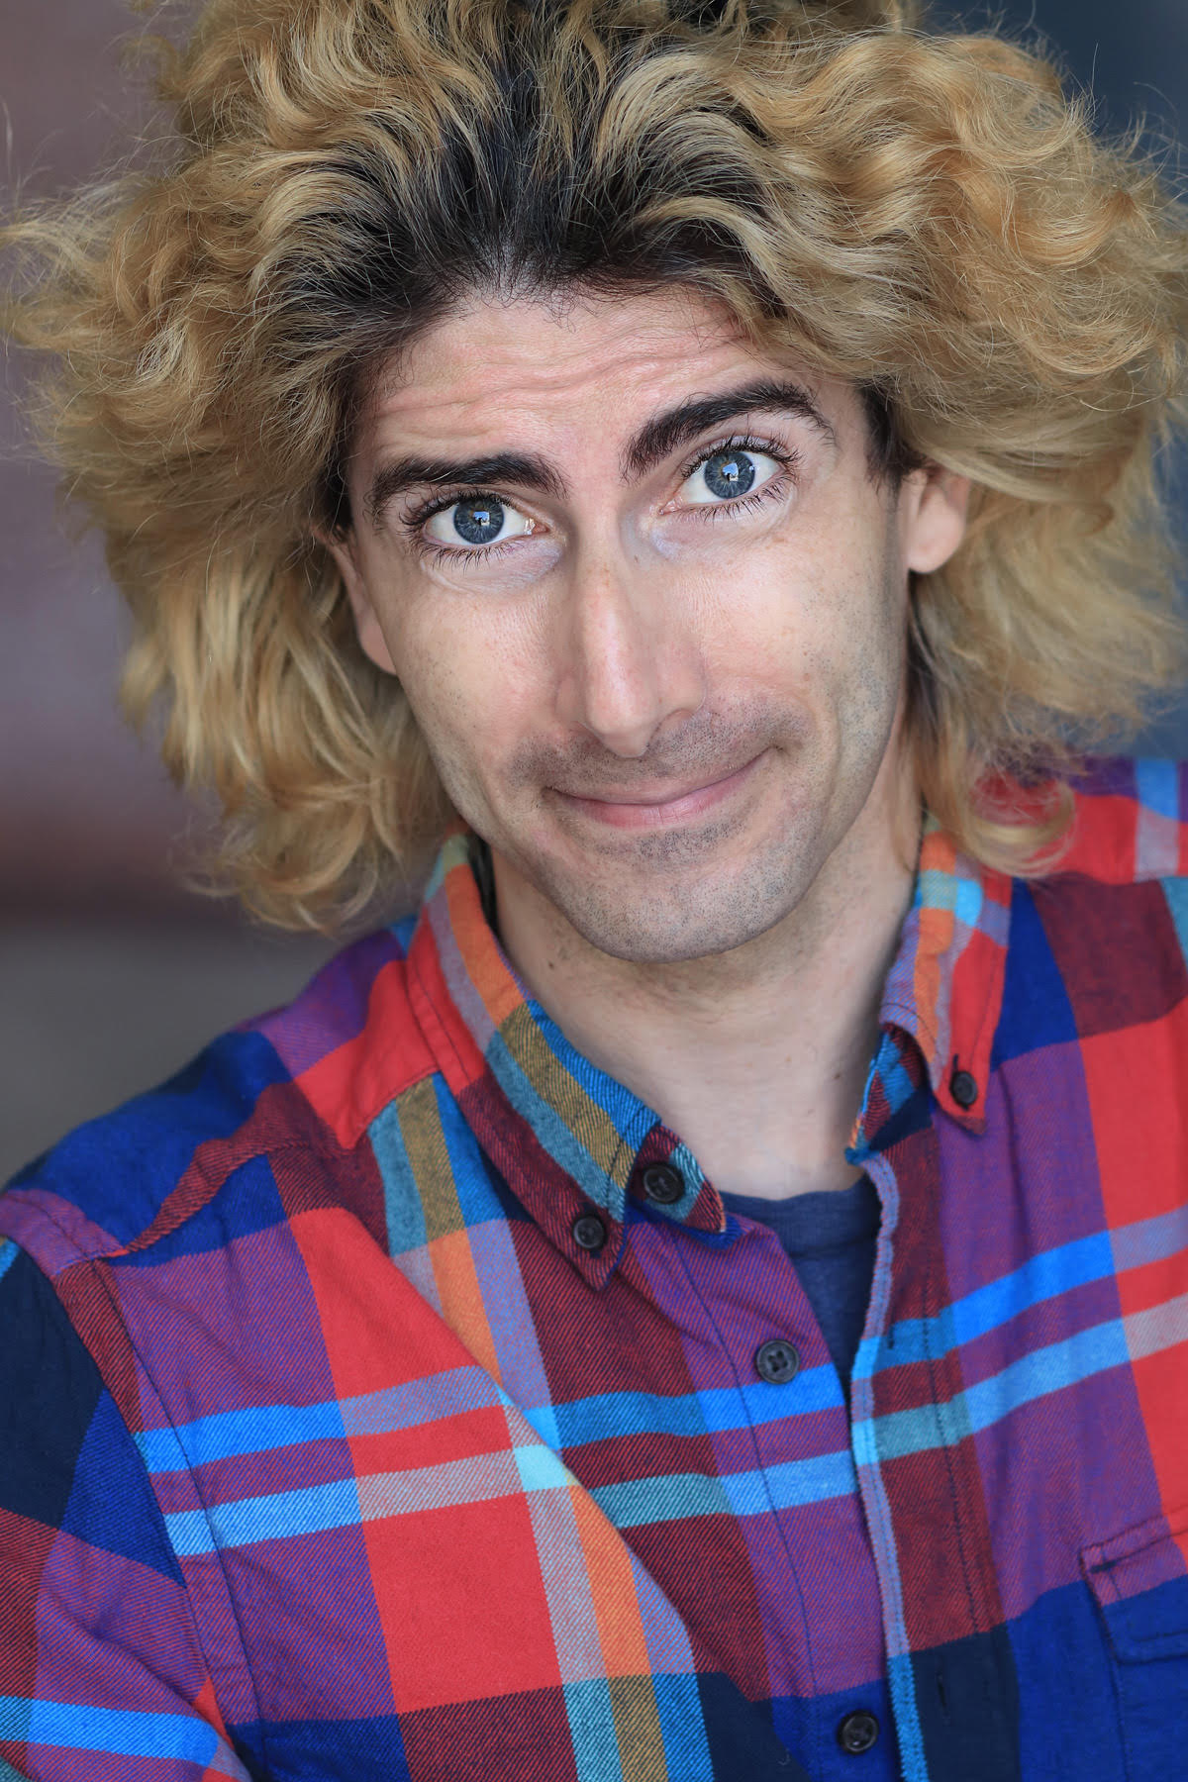
People slide 4
NATE
Writer/Actor
ASHNA
Actress/Director
JOE
Actor/Voice Over
Nate Raven currently lives in Los Angeles after enjoying a successful musical theater career in NYC. He’s written two award winning short films, as well as plays and TV series. He is a leader for Indie Film Theater’s Writer’s Room (a new streaming platform for theater and filmmakers) and a ‘script doctor’ on the side.
He loves representing voices that have barely been heard or not at all.
Award winning filmmaker and former pageant queen from Virginia, Ashna Sharan moved to LA to pursue her dreams to be on the big screen! Growing up as a classically trained dancer, she learned to express herself through movement which eventually helped with her acting. Ashna loves pouring her heart and soul into socially conscious storytelling.
Joe Filippone
is from Denver, Colorado. An actor for 30+ years, he’s appeared in films, TV, webseries, video games, commercials,
theater productions, animated films and series, and even in non-sex non-nudity roles in adult films.
Joe loves Asian horror movies and all things occult.
Voices On Paper

Slide 10
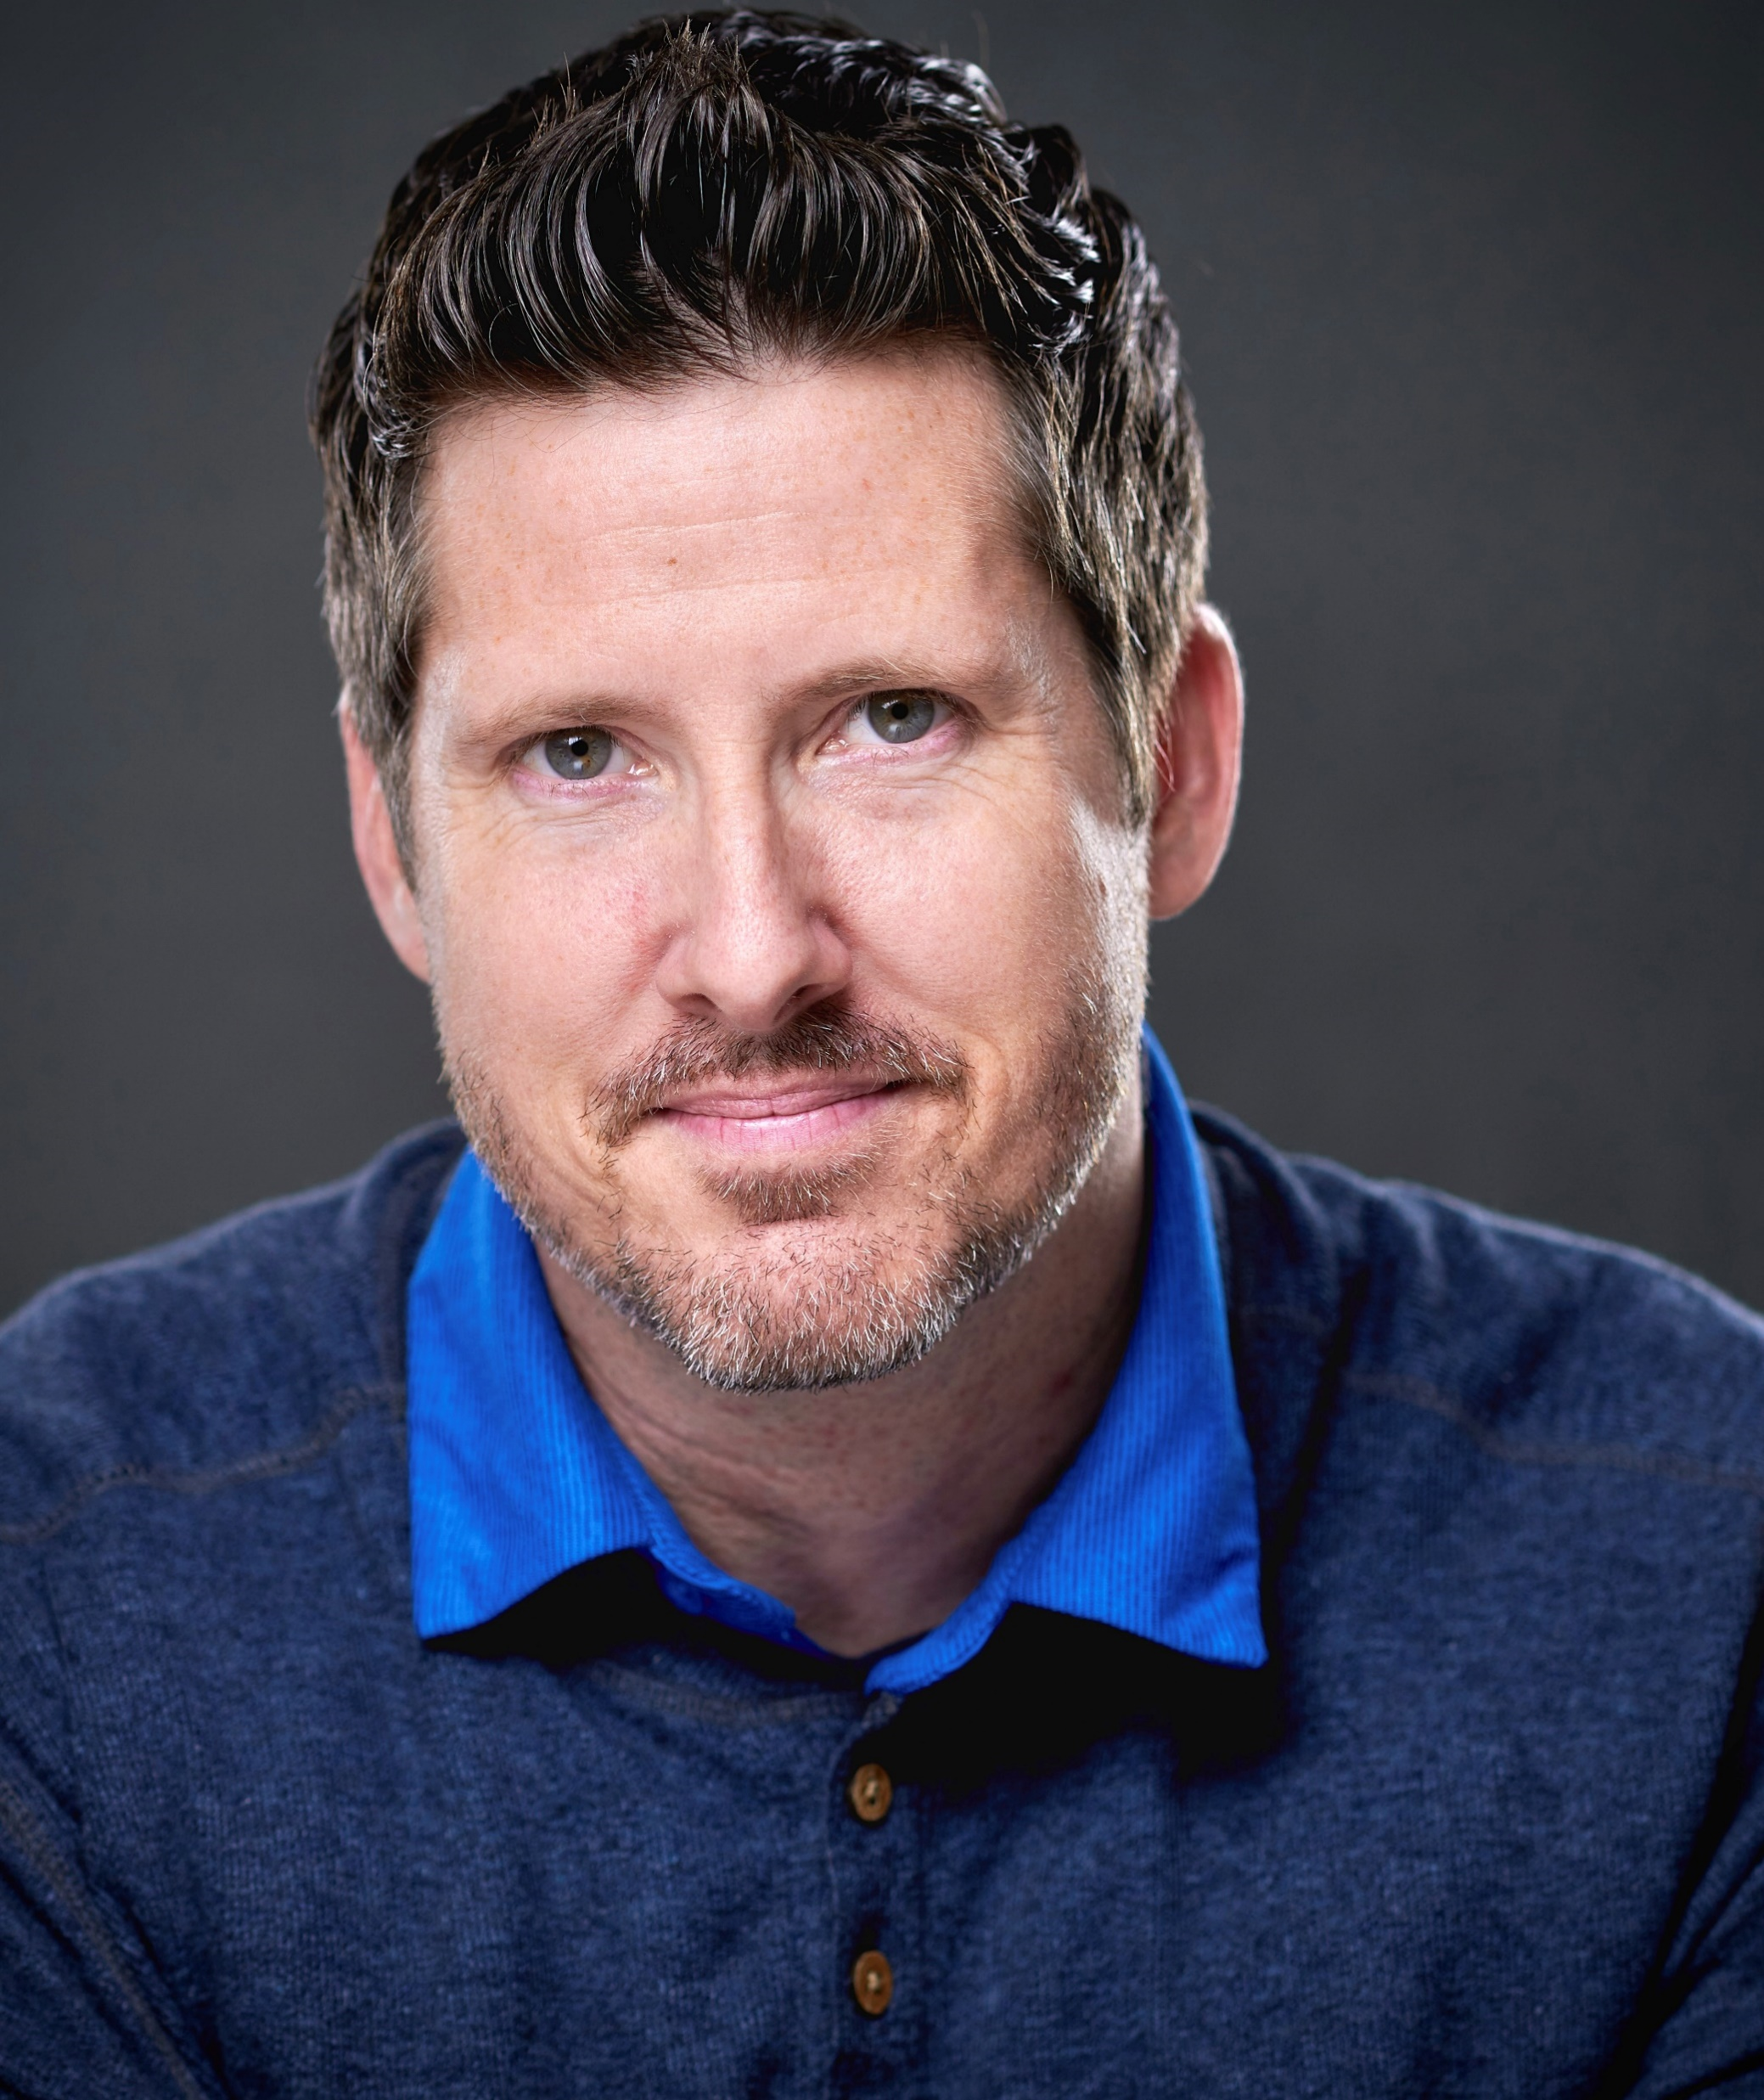
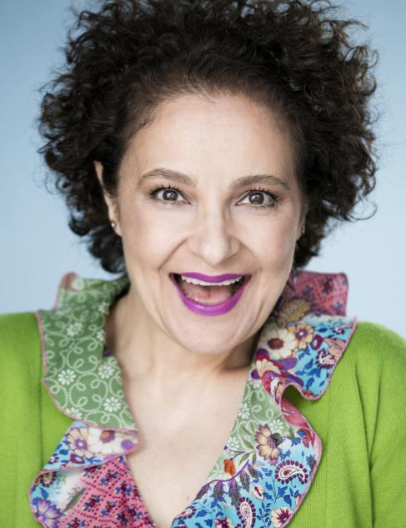
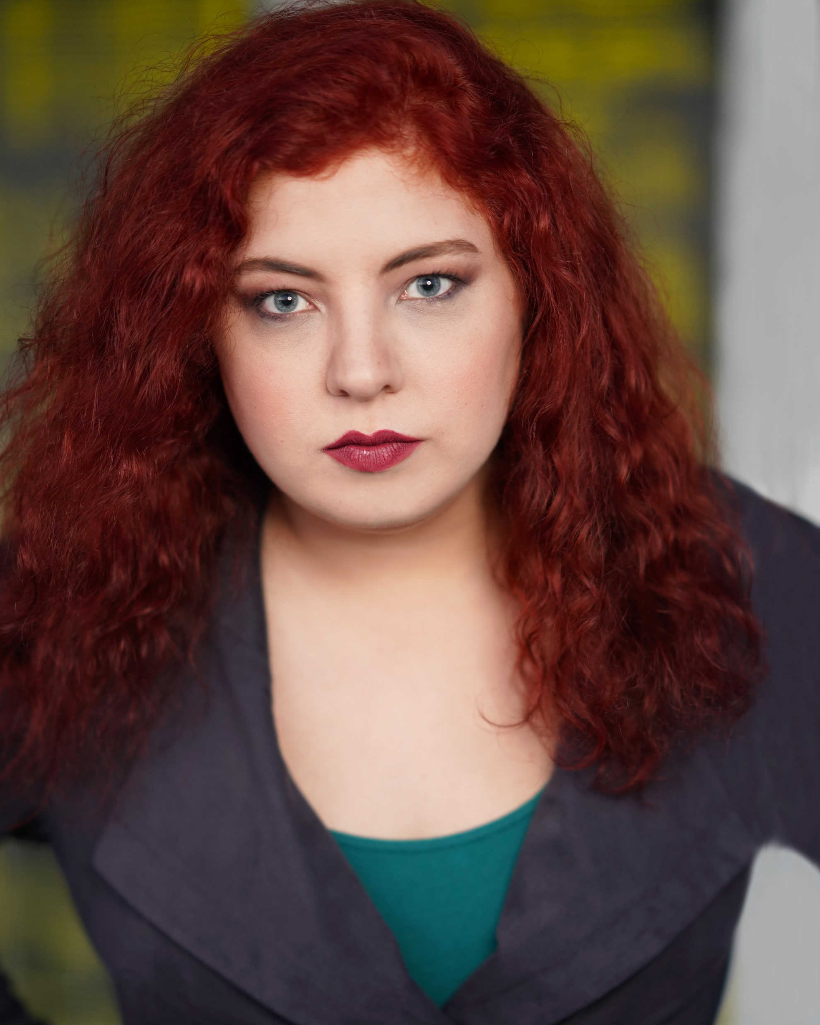
People slide 7
J J
Writer/Actor
SHARI
Writer/Actor
DEIDRA
Actress/Filmmaker
JJ Duffy is an LA based writer, actor, and gay dad who loves helping you find more comedy in your script, talk about characters, and figure out pacing in his upbeat encouraging way.
He’s written hundreds of sketches, shorts, commercials, and feature length scripts, and is the head writer, creator and star of Gym Shorts Comedy on Amazon.
Shari Vasseghi is an Iranian native with lots of jokes under her burqa from 10+ years of experience in Stand-up comedy.
A huge believer of being a light onto humanity through her writing, Shari’s comedies aim to inspire a better world.
She enjoys telling character driven stories with strong Persian-American female leads.
Originally from Toledo, Ohio, Deidra Kathleen has earned degrees in film and theatre, and graduated from Second City - Hollywood's improv conservatory. She’s a stand-up comedian, has earned awards for film and acting, and even got a chance to work with her childhood idol, A.J. McLean. She adores theatre, fantasy, sci-fi, and improv.
Voices On Paper

Slide 11
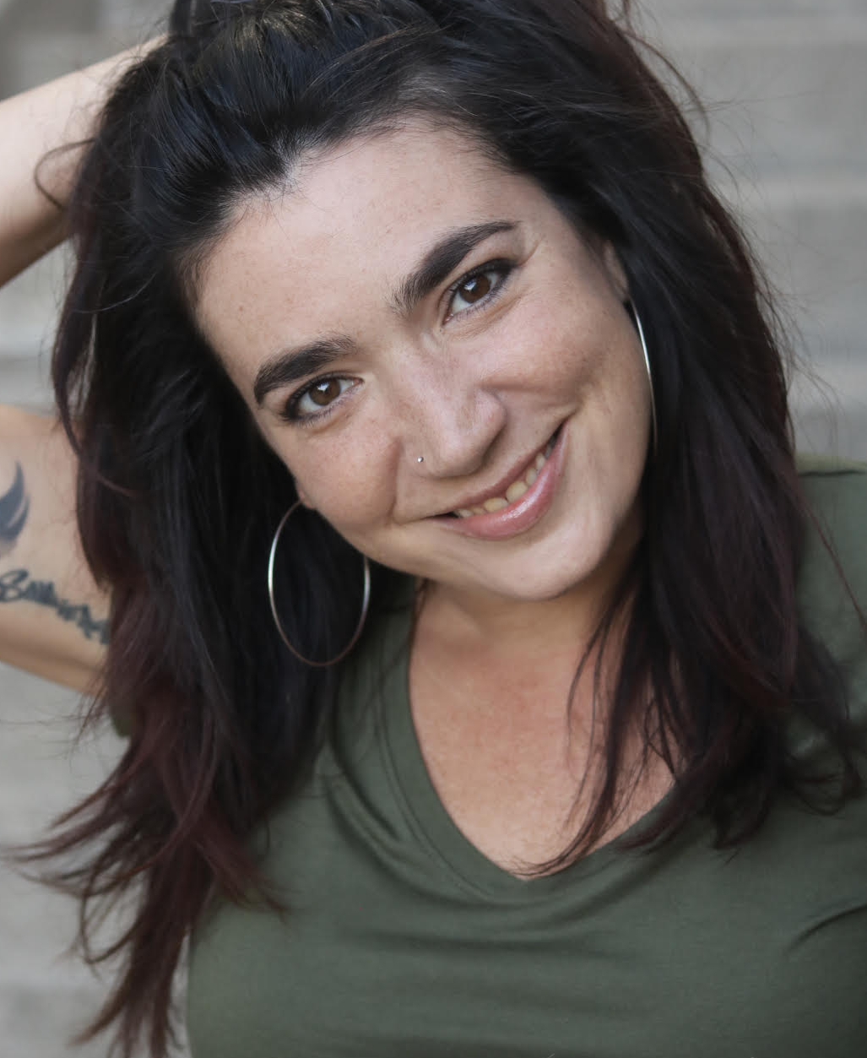
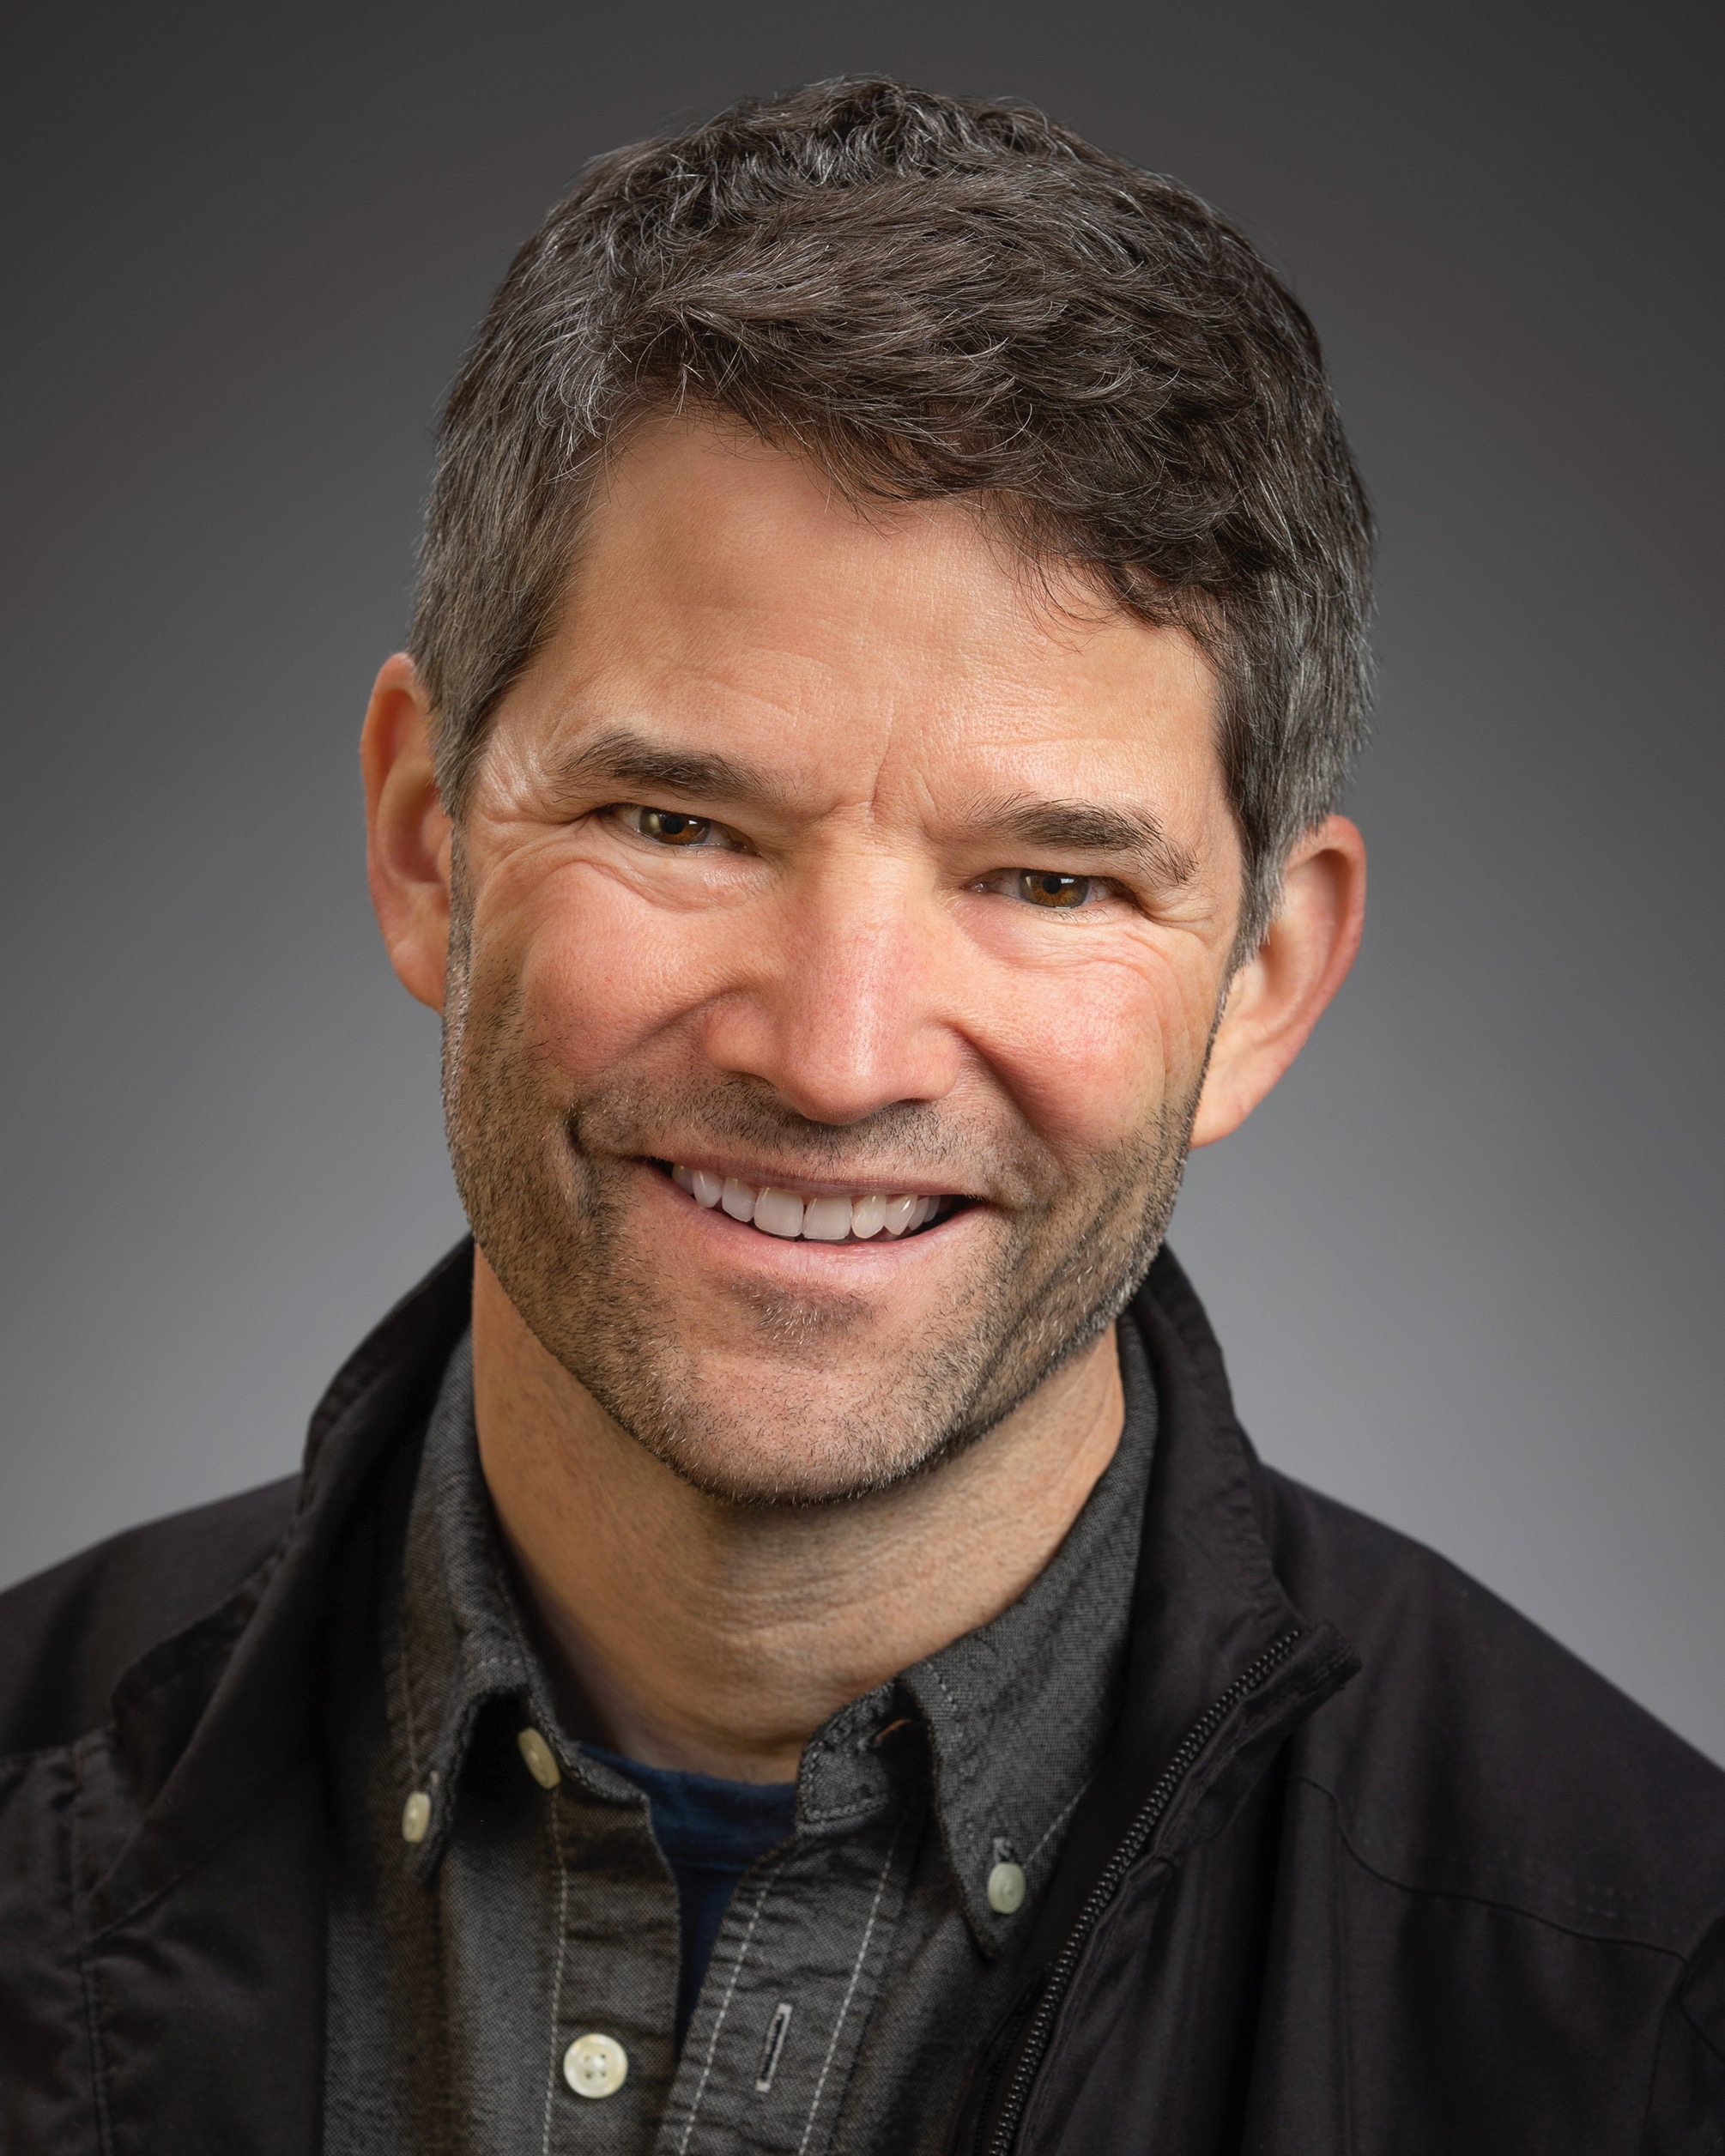
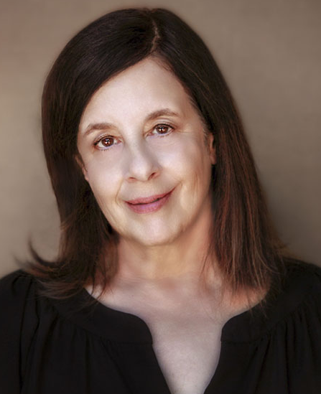
People slide 6
SOPHIA Actor/Director
WAYNE
Actor/Musician
ROBIN
Actress
Sophia LaPaglia comes from a theater background where she started as a child and has been working as a professional actor for over 25 years. After many years of training in NY and a long running one woman show in San Francisco, she recently decided to make the move to LA where she is pursuing acting, directing, coaching, and screenwriting.
Wayne Jay is an actor, voice actor, singer/songwriter, and musician currently
living in Ohio.
It's pretty unlikely that you've seen or heard anything he's done.
He spent most of the
last four decades working as an aerospace engineer by day and a stage performer by night
in a variety of states, countries,
and continents.
A transplant from Queens, NY to Los Angeles, CA Robin S Roth has been active in theater, film,
and TV. She can be seen in “Goin’ Around” {Best Feature, 2020 LA LIVE Film Festival]; “Jessie The Golden Heart” with Eric Roberts [Best Feature Finalist, 2019 LA Femme International Film Festival];
and more.
Voices On Paper

Slide 12

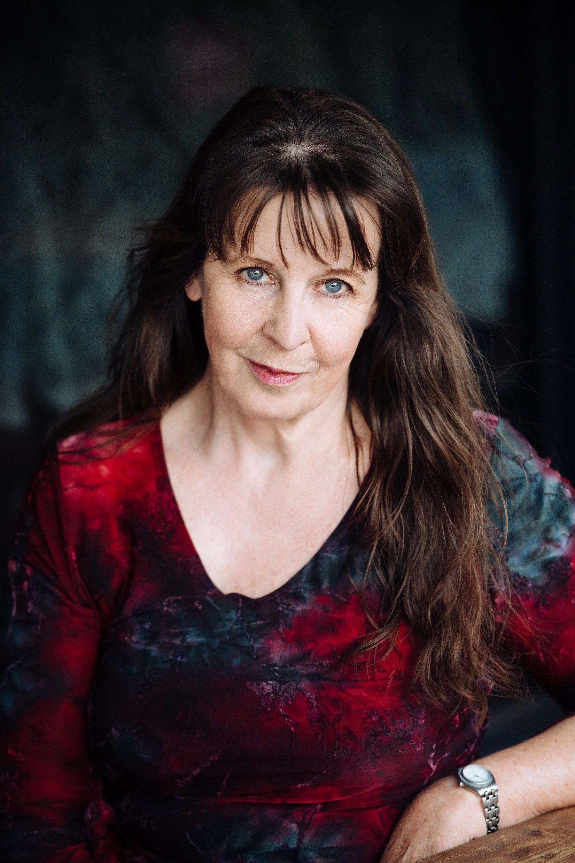
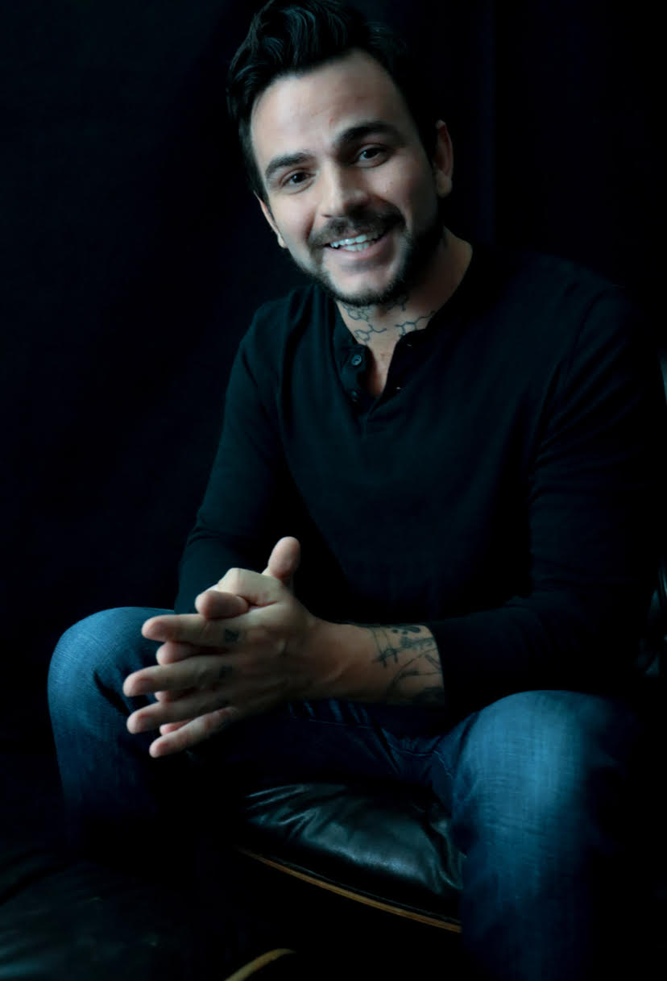
People slide 1
TRISTAN
Actress/Acrobat
DIANA
Screenwriter/Actor
JEREMY
Actor/Comedian
Tristan Cunningham
is a S.U.N.Y Purchase Theater Arts and Film Conservatory Graduate and a proud member of AEA and SAG-AFTRA. You can see her in Season 1 of All Rise on CBS, Season 1 of The Fugitive starring Kiefer Sutherland, Season 18 of NCIS, on Fox's 911 and Netflix’s Family Reunion, and featured in Lethal Weapon, Solve, and Bit.
Diana Black
is an Aussie-American
optioned screenwriter and competition finalist for features and television.
Her extensive actor training is via
The Method, Meisner,
and Practical Aesthetics.
She has a Bachelor of Creative Arts degree majoring in Drama,
Film & Television.
Jeremy Pace
is a comedian, actor, writer – a poet since he was 6 years old. Before Los Angeles, he was seen on stage as an actor, burlesque personality, improv performer, storyteller, and poet, now pursuing his dream stand-up comedy career. He currently hosts Misfits Comedy Party with his comedy sidekick.
Voices On Paper

Slide 13
The VOP Team
communications
CristiAna “Cris” Felipe
CristiAnaCrisFelipe@gmail.com
Nate Raven
natesuggs@gmail.com
Ashna Sharan
modelashna@gmail.com
Joe Filippone
joefilipponeactor@gmail.com
JJ Duffy
actorjjduffy@gmail.com
Jeremy Pace
jeremydpace@gmail.com
Diana Black
diana@dianatblack.com
Simone Thomas
simonteresias@gmail.com
Robin Roth
rroth24@yahoo.com
Tristan Cunningham
Tristan.Cunningham1@gmail.com
Sophia LaPaglia
Sophia.lapaglia@gmail.com
Wayne Jay
waynemjay@gmail.com
Deidra Kathleen
deidrakathleen@gmail.com
Shari Vasseghi
1sharivasseghi@gmail.com
Dale Madison
dale@damngoodman.com
Joel Handler
jhandlerwriter@gmail.com
Voices On Paper

Slide 14
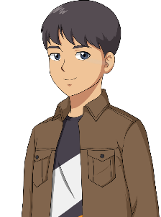
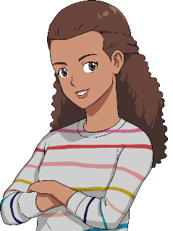
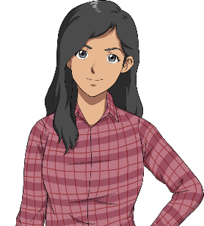
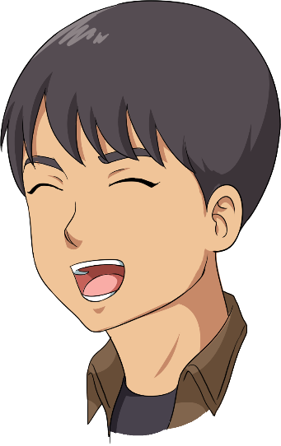
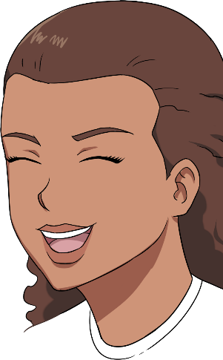
Example slide 3
I am so thankful for Voices on Paper - they really took time to dig into our script and give thoughtful and insightful feedback, as well as compelling performances. Each of them were so invested in our script, and I felt like they were really invested in giving us feedback that would be helpful to our rewrite process.
I will certainly be reaching out to this group again for more readings, and will recommend them to anyone looking for a
table read, with notes!
So many things came up that we never
would have thought of, and I really appreciated the group's kind, but honest notes.
- Selena Moshell, Director
TESTIMONIALS
All of the actors were professional
as well as personable,
giving genuine and
layered notes on the material
as well as putting their all
into the performance.
Friendly and enthusiastic,
I would happily work with
all of them again!
- Jared
Matusich,
Writer
Can’t say enough great
things about Voices on
Paper reading group.
They were extremely
professional, well prepared and gave fantastic feedback.
I also really loved the
diversity of the group and
their different backgrounds.
I would definitely use them
again and highly recommend
them to other writers and
directors.
- Allison Calleri,
Producer

Slide 15

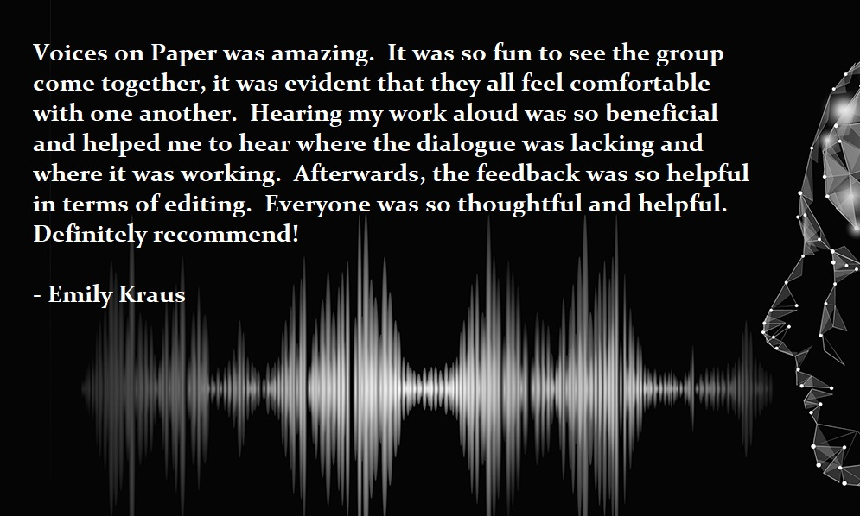
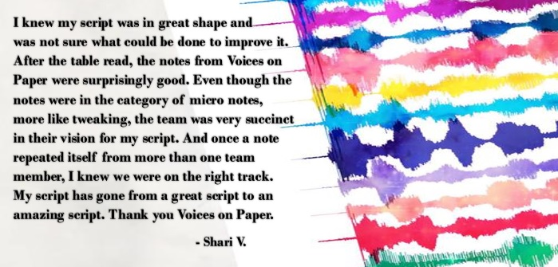
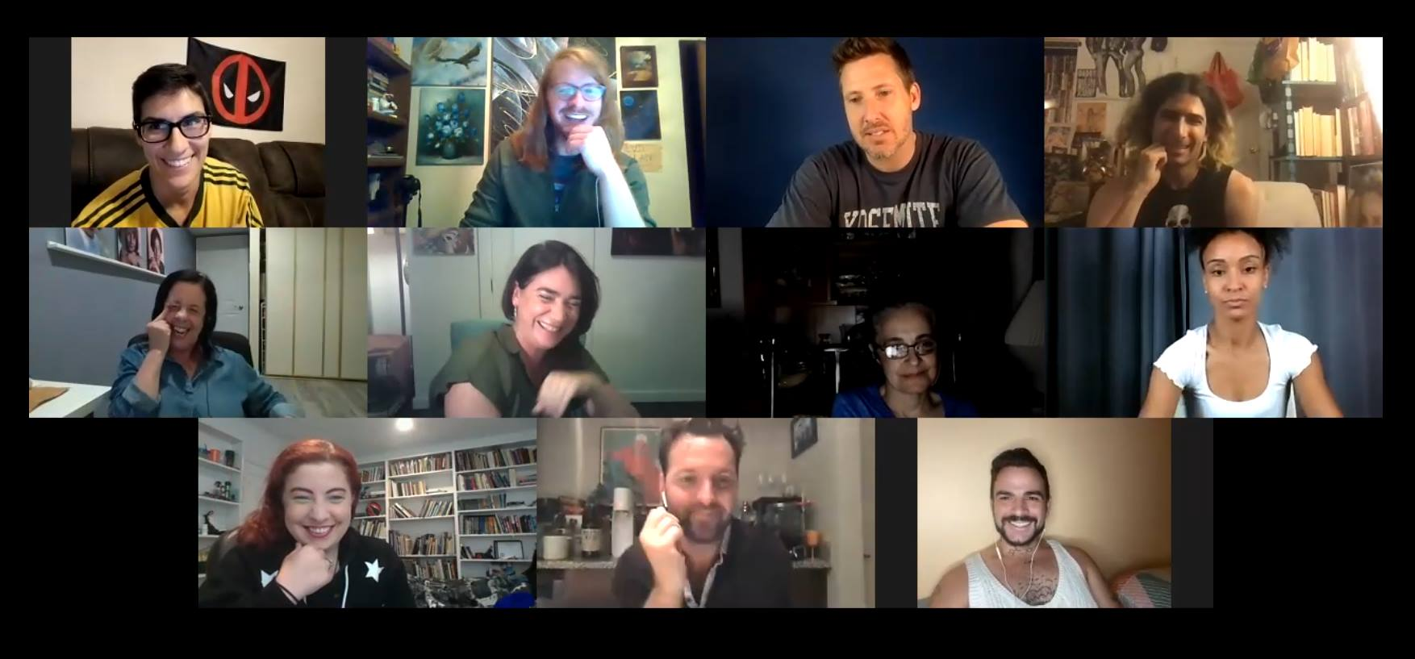
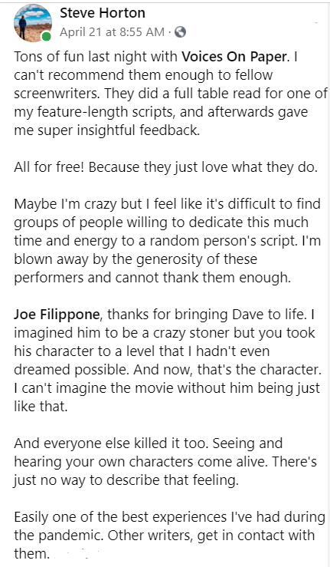
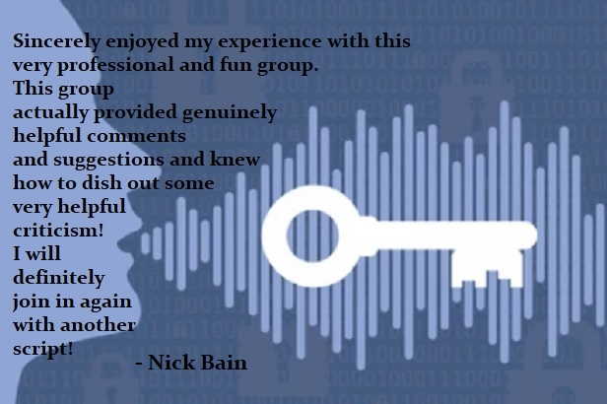
yourVoicesOnPaper.com

Slide 16
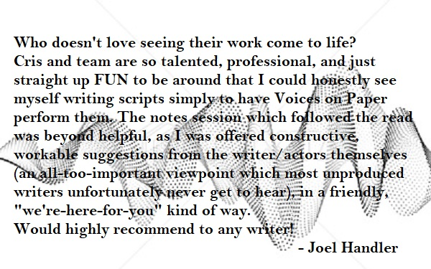
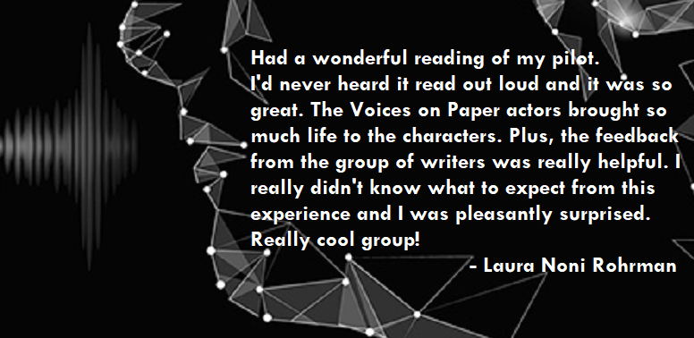

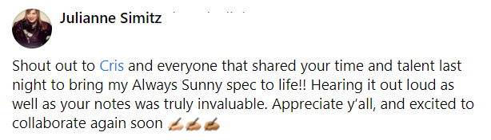
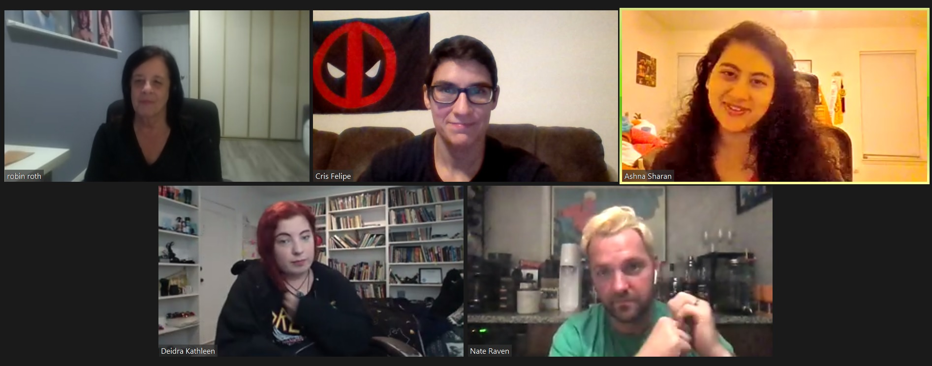
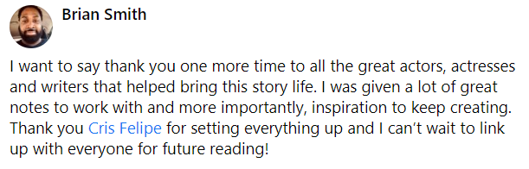

Slide 17
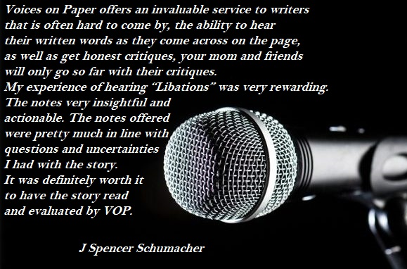






Slide 18


THANK YOU
from
VOICES ON PAPER

